Slide 1
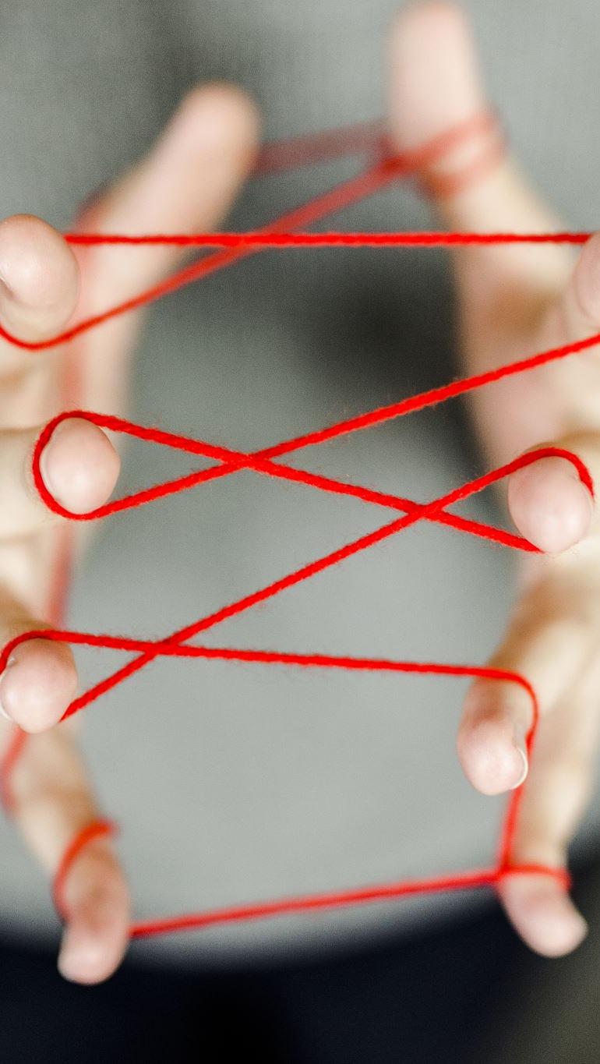
Coordination and Response
Part One

Slide 2
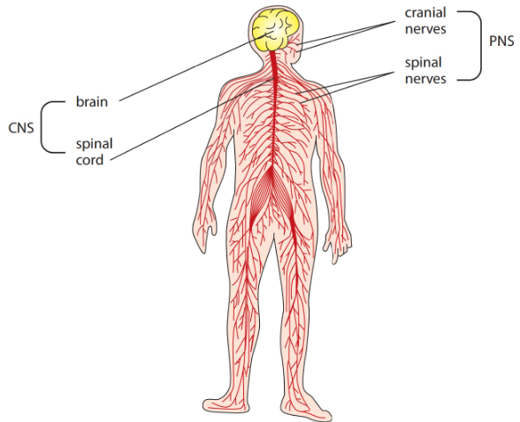
Nervous system consists of two parts
1- Central nervous system(CNS):
Consists of brain and spinal cord
2- Peripheral nervous system(PNS)
Consists of cranial nerves(from the brain), spinal nerves and sensory organs

Slide 3
What are Effectors? • Effectors are the muscles and glands which go into action when they receive impulses or hormones. The Nerve Impulse It is a series of electrical signals, which travel down a nerve fiber. All nerve impulses are similar (of electrical nature) but they go to different parts of the brain to be interpreted. Speed of pulse: 100 m per second.

Slide 4
• Types of Impulses Sensory Impulses: these are nerve impulses from the sense organs to the CNS. • Motor Impulses: these are impulse from the CNS to the effectors.

Slide 5
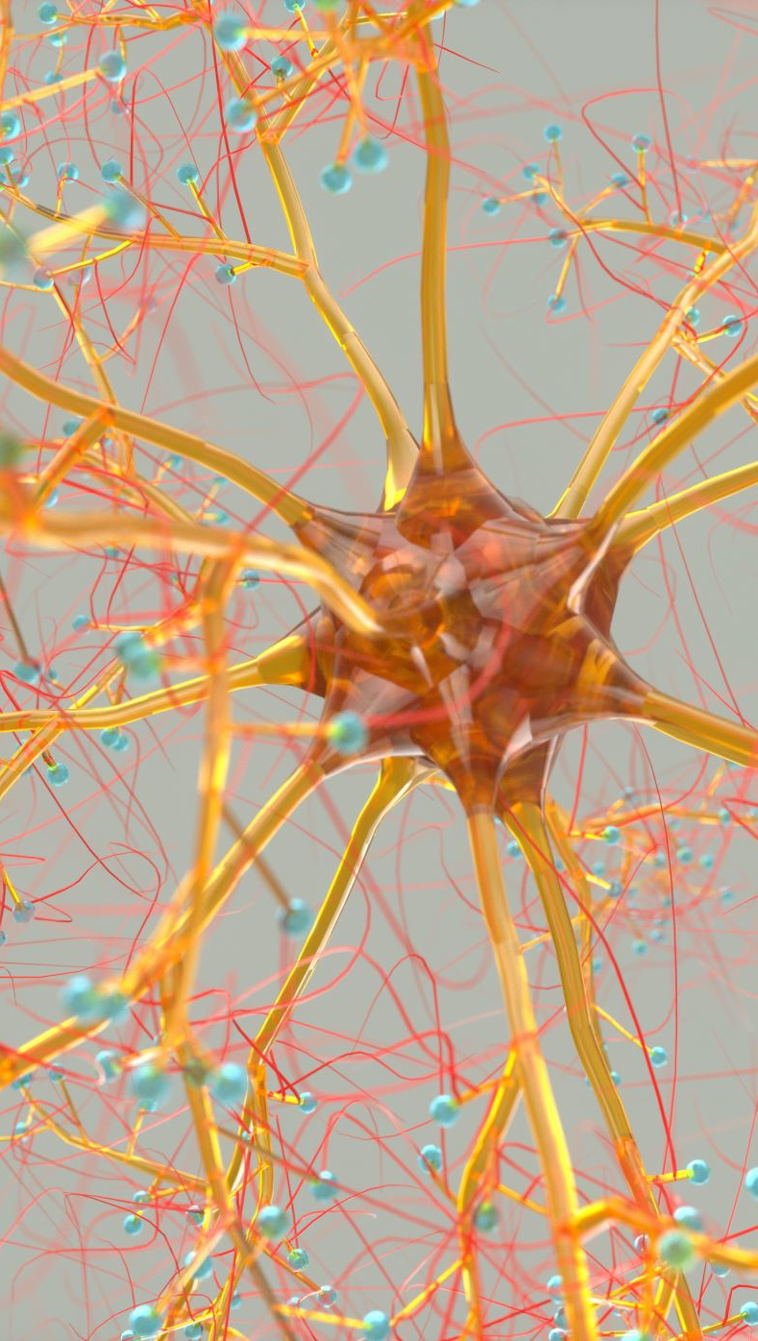
• What are Neurones?
Neurones are the nerve cells.
• There are three types of Neurones:
• Motor Neurones
• Sensory Neurones
• Relay Neurones

Slide 6
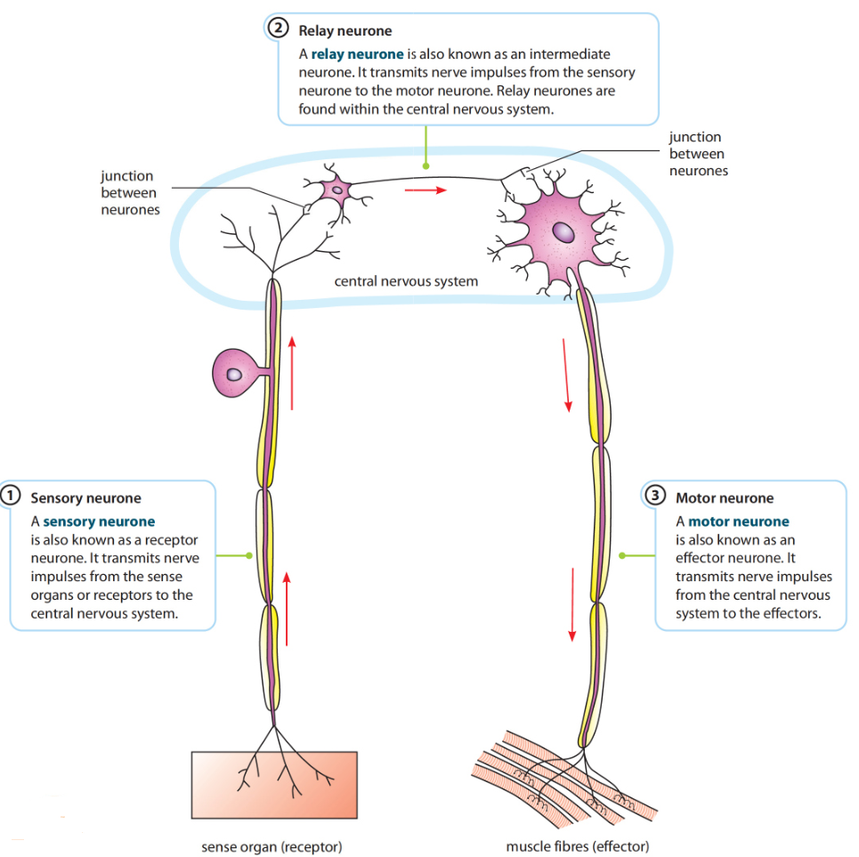

Slide 7
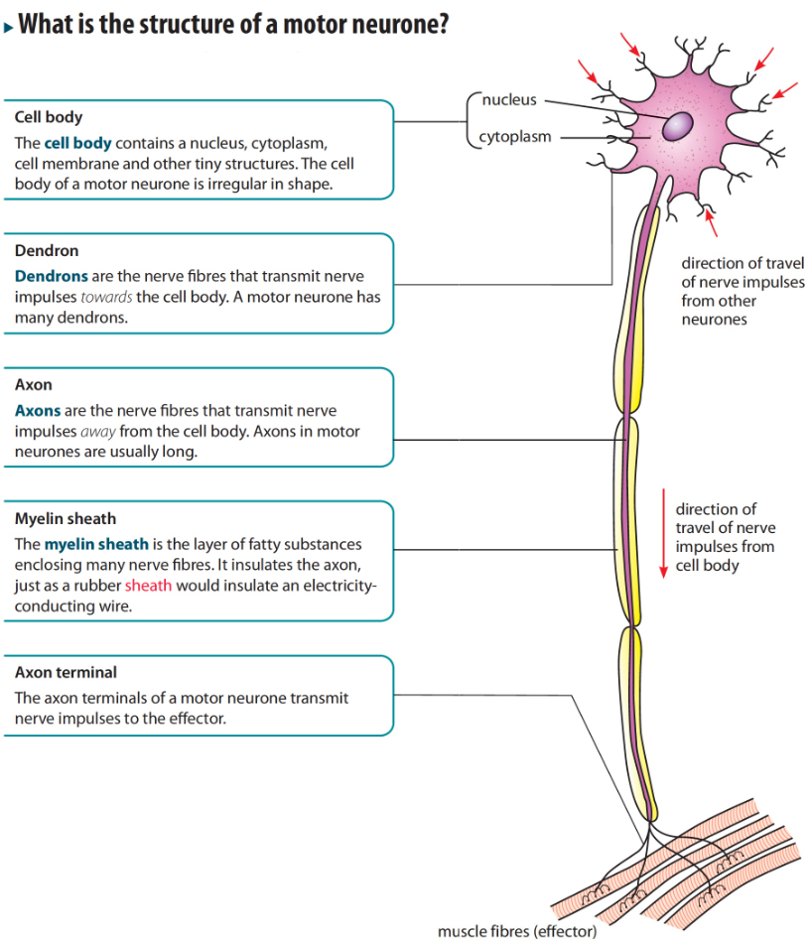

Slide 8
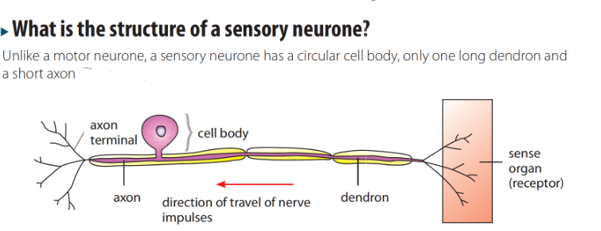
Sensory Neuron

Slide 9
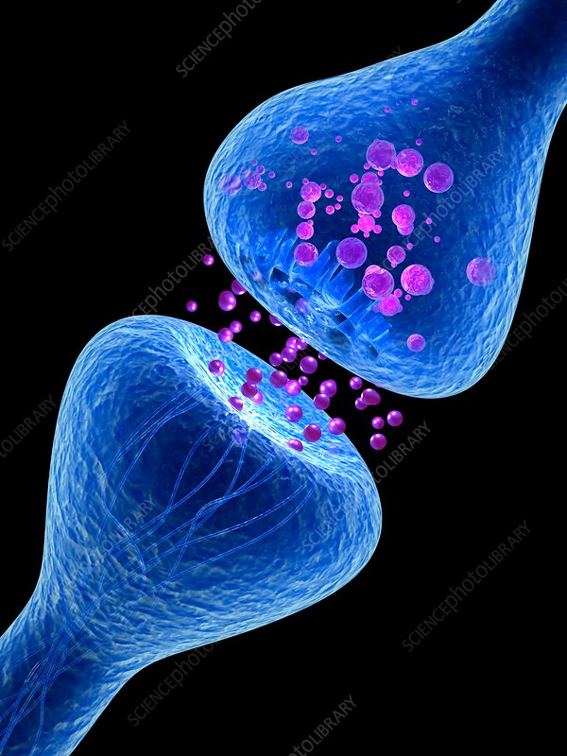
Synapse
• Synapse: a junction between two nerve cells, consisting of a minute gap across which impulses pass by diffusion of a neurotransmitter.
• At a synapse, a branch at the end of one fiber is in close contact with the cell body or dendrites of another neurone.

Slide 10
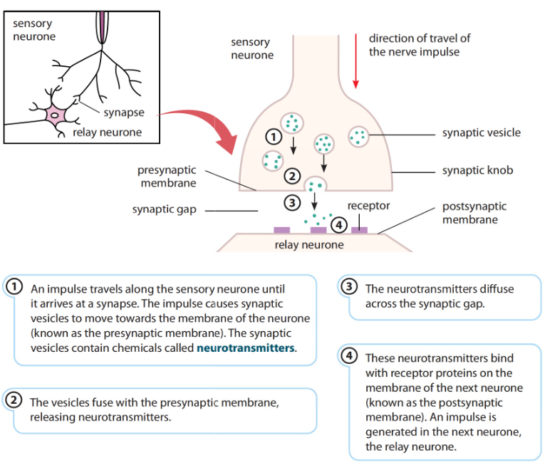

Slide 11
Synapses ensure that nerve impulses only travel in one direction • There is only neurotransmitter on one side of the synapse(presynaptic membrane), so the impulses can only go across from that side. • The receptors of neurotransmitter are on the other side.(post synaptic membrane)

Slide 12

How does the nervous system process information
A- Sensations
B- Voluntary Actions
C- Reflex Actions

Slide 13
What is reflex action?
Is an immediate response to a specific stimulus without conscious control
Reflex actions are rapid and automatic
Reflex actions are examples of involuntary actions
There are two kinds of reflex actions:
A- Cranial Reflexes
Controlled by the brain and usually occur in the head region. Ex, pupil reflexes, blinking, salivation
B- Spinal Reflexes
Controlled by the spinal cord. Ex, knee –jerk reflex

Slide 14
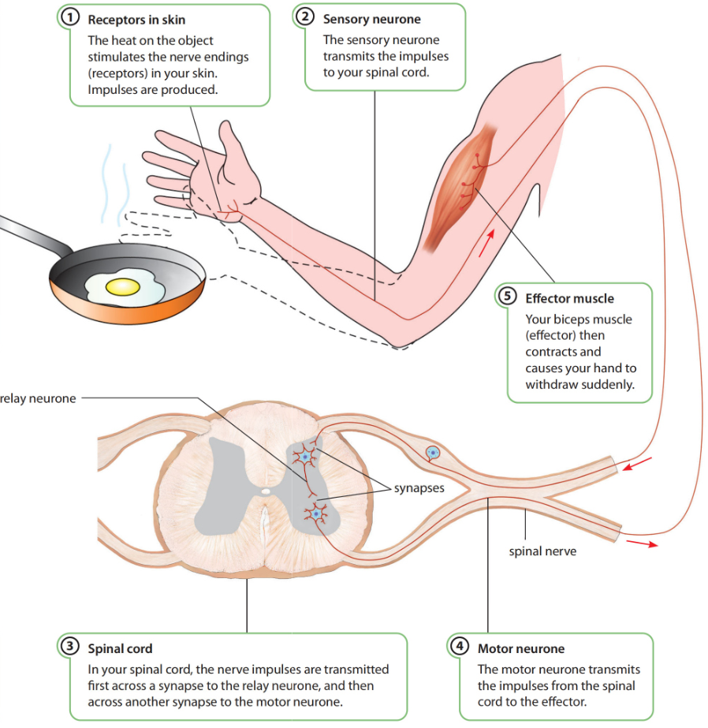
What happens when you touch hot object?

Slide 15
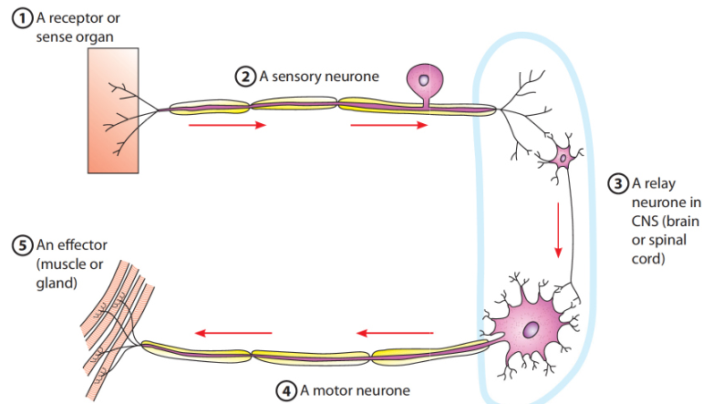
What is a reflex arc?
Is the shortest pathway by which nerve impulses travel from the receptor to the effector in a reflex action

Slide 16
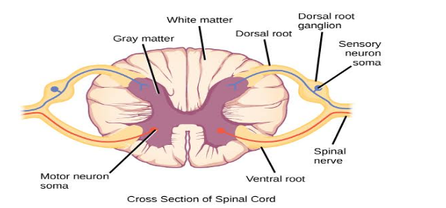
Spinal cord
Spinal Cord: is a long white cord, consisting of thousands of nerve cells. It is protected by the vertebral column.
•In a transverse section, a spinal cord, shows two zones, an interior grey matter which contains the cell bodies of motor and connector neurones, and external white matter which contains nerve fibresof neurones.

Slide 17
The spinal nerves divide into two roots at the point where they join the spinal cord. •Dorsal root–contains the sensory neurons. The cell body of these neuronesare found in ganglion in the dorsal root. •Ventral root -contains motor fibers of motor neurones.

Slide 18
Function of spinal cord It concerns with: 1- Reflex actions involving body structure below the neck. 2- Conducting sensory impulses from the skin and muscles to the brain. 3- Carrying motor impulses from the brain to the muscles of trunk and limbs.

Slide 19
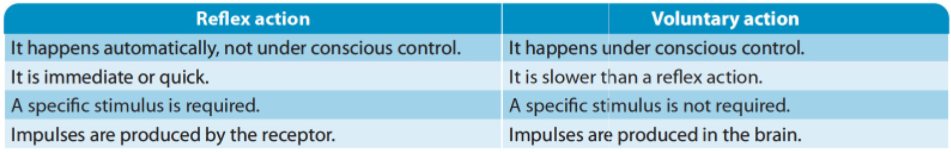
How is reflex action different from voluntary action?

